Slide 1
INTRODUCTION Richard Patterson Assistant zone Officer Environmental Protection Division
Keep Vanuatu‘s Environment and its people’s health safe from harmful chemicals and their wastes

Slide 2
Make Laws and Regulations, e.g. Waste Management Act ,Ozone Layer Protection Act and the Pollution Control Act

Slide 3
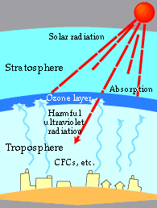
OZONE
Protect the Ozone Layer and Stop Global Warming
Ozone layer (made of Ozone, O3) is a very thin layer that exist about 15km from the earths surface. It acts like a blanket to protect the earth from harmful UV light.
Gases used in fridges and air-conditioners can break the ozone layer
The Gases also contribute to Global Warming

Slide 4
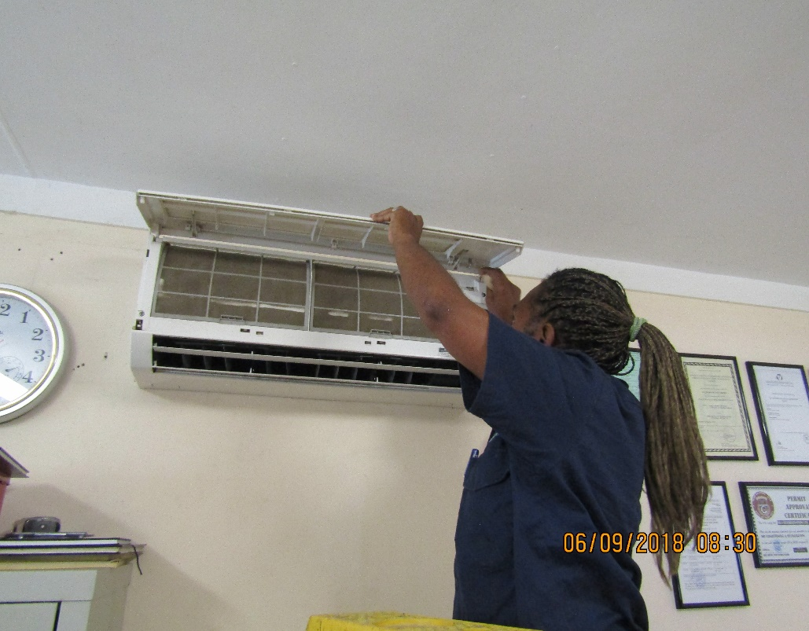
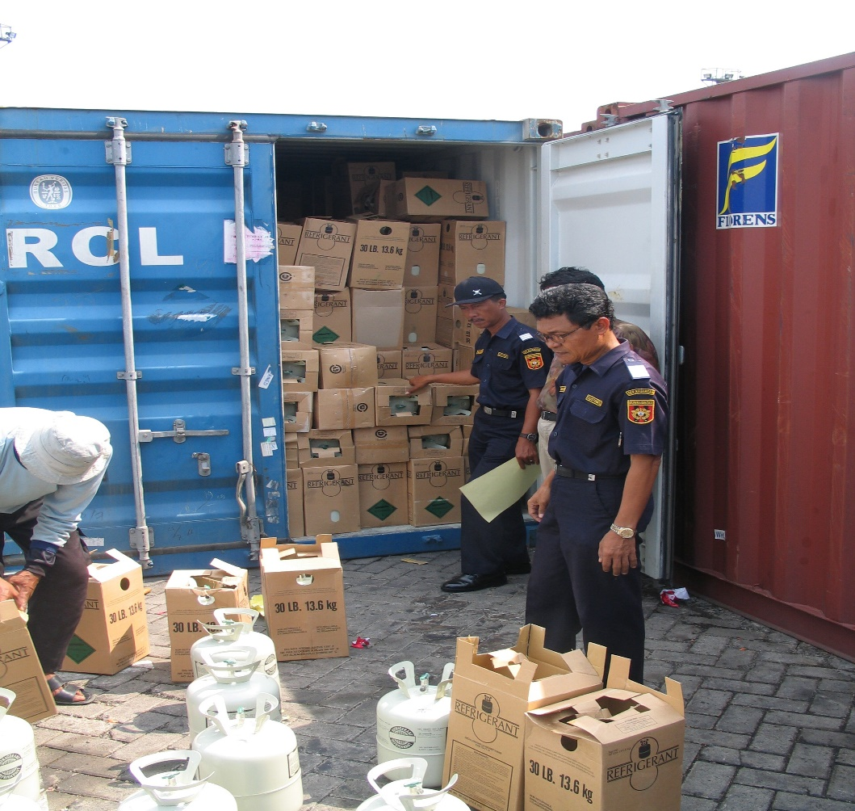
PEOPLE DIRECTLY INVOLVED WITH THE GASES
RAC Technicians
Customs Officers

Slide 5
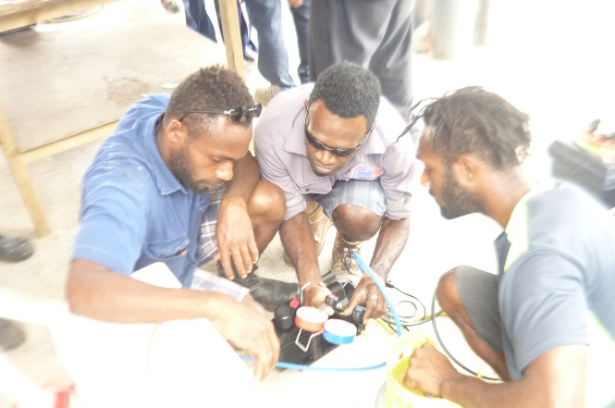
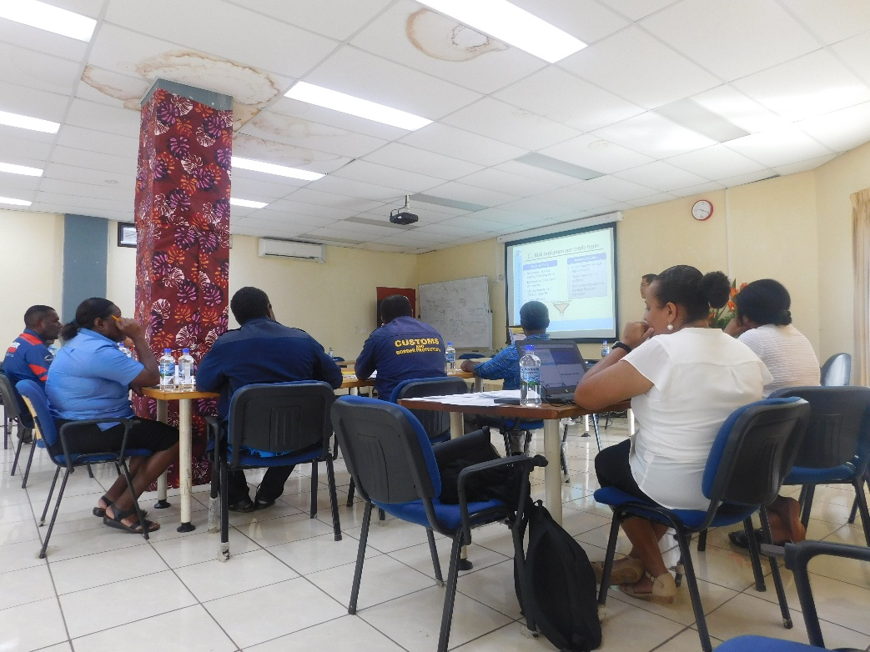
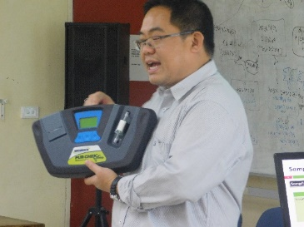
Training & Information Sharing
Training helps Technicians to:
Know the Laws of the Gases they work with
Reduce Leaking of the Gases in their work
Must not allow gases in fridges and air-conditioners to leak
Training helps Customs Officers to:
Spot illegal imports of the gases
Use equipment to test for illegal gases etc.
Training helps Custom Brokers to:
Know types of gases and their codes so they write in the correct information when they order the gases for their customers

Slide 6
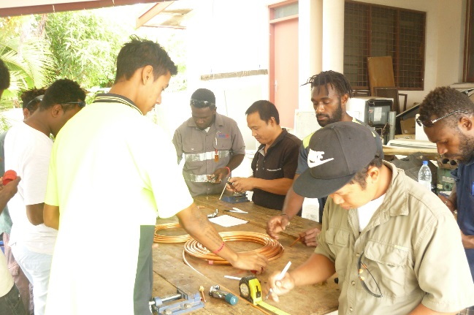
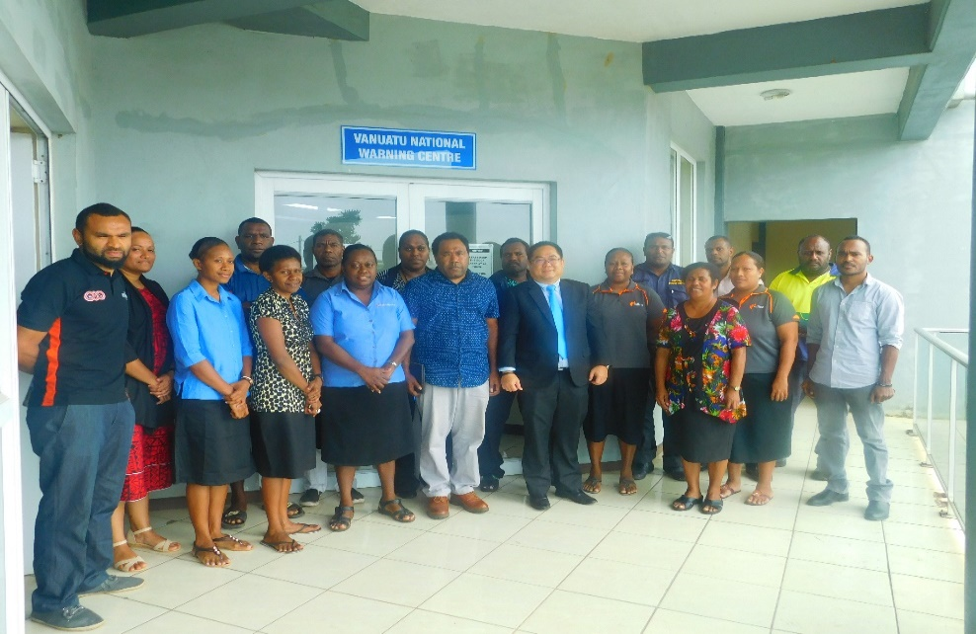
Nov 2017
Training to RAC technicians in Port Vila
Aug 2017
Training to Customs Officers and Brokers in Port Vila

Slide 7
Which STUDIES can you do to work as an
“Environmental Officer” in the
Environmental Protection Division?
Environmental Chemistry
Environmental management
Environmental Science
Environmental Law

Slide 8
CONCLUSION
The environment is our LIFE
DEPC would like to encourage you all to assist in any small way to keep Vanuatu’s environment clean and safe .
This must start in your own home/ school and to your community.
Keep Vanuatu Beautiful and SAFE
More Info Contact: DEPC on 25302

